Slide 1

Title Product Tracking and Tracing with Decentralised Blockchain
Domain
Blockchain
BATCH NUMBER : A12
NAMES OF THE TEAM MEMBERS
AISHWARYA SURESH (211417104007)
DEEPIKA P (211417104047)
KIRUTHIKA S (211417104121)
GUIDE NAME
Mrs.K.KIRUTHIKA
Assistant professor

Slide 2
INTRODUCTION
In a supply chain management system the smart tags(like QR,NFC) are used in order to store the product details. By that the consumers can also track the products during entire life cycle. Product consumers have no knowledge about the data’s that is provided in the smart tags by the smart tag creators and stack holders are true or not. The DL-Tags solution steps into this environment to offer a decentralized, privacy-preserving, and verifiable management of Smart Tags during a product’s lifecycle.
The solution is based on distributed ledger technology(DLT) and uses the Block chain to mediate interactions between the stakeholders during a product’s exchange process.
Our work describes the DL-Tags solution and includes a cost analysis of all implemented transactions on the Blockchain. The proposed solution provides evidence of the product’s origin and its journey across the supply chain while preventing tag duplication and manipulation. It is among the first documented practical solutions using DLT and IoT for supply chain management, which is designed to be distributed ledger agnostic.

Slide 3
LITERATURE SURVEY
S.NO | TITLE | YEAR | AUTHOR | INFERENCE | DRAWBACK
1. | Block chain and Smart Contracts for Internet of Things: A Systematic Literature Review ¹ | 2019 (International School of Software,Wuhan University, China) | Anup Dhakal, Xiahui cui | It is very advantageous to track the goods and find out whether the products are counterfeit or real. With Block chain and IOT, empty-apartments, spare bedrooms, houses, cars, or vacant conference rooms will rent themselves out. Patents will license themselves. Our e-mail will be able to charge spammers for each item received. | Some challenges that cannot be solved by using technologies designed for traditional internet. Open source system may be susceptible for exploitations and accidents.

Slide 4
LITERATURE SURVEY
S.NO | TITLE | YEAR | AUTHOR | INFERENCE | DRAWBACK
2. | A privacy-preserving Internet of Things device management scheme based on blockchain ² | 2018 (International Journal of Distributed Sensor Networks, Vol. 14(11) ) | Qingsu He, Yu Xu, Zhoubin Liu Jinhong He,You Sun, and Rui Zhang | The policies are posted on the block chain, so it is visible to all the users, and it can avoid the third-party ultra vires. It can easily realize the transfer of access rights without the need for the involvement of resource owners and make the authority management more flexible. | No block chain system can support time bound and attribute based access with high efficiency. Very difficult to directly establish trust between two strange entities without a third-party center.

Slide 5
LITERATURE SURVEY
S.NO | TITLE | YEAR | AUTHOR | INFERENCE | DRAWBACK
3. | Applications of Blockchains in the Internet of Things: A Comprehensive Survey ³ | 2017 (The University of New South Wales (UNSW)) | Ali Dorri, Salil S. Kanhere, and Raja Jurdak | Achieve decentralization, security and auditability. The trustless network environment of block chains allow secure micro-transactions for IOT services and data. | High server maintenance costs. Centralized server has the risk of being deleted or tampered with.

Slide 6
LITERATURE SURVEY
S.NO | TITLE | YEAR | AUTHOR | INFERENCE | DRAWBACK
4. | ETHEREUM: A SECURE DECENTRALISED GENERALISED TRANSACTION LEDGER EIP-150 REVISION (1e18248 - 2017-04-12) ⁴ | 2017 (FOUNDER, ETHEREUM & ETHCORE ) | DR. GAVIN WOOD | It is possible to use the internet to make a decentralized value-transfer system, shared across the world and virtually free to use. Ethereum is an specialized version of a cryptographically secure, transaction-based state machine. | It has too many platforms. It is the biggest minus of this crypto money. There are can be some breakdowns in the system. In order to upgrade the project to a new level, this block chain will switch from being Proof of Work to Proof of Stake.

Slide 7
LITERATURE SURVEY
S.NO | TITLE | YEAR | AUTHOR | INFERENCE | DRAWBACK
5. | First purpose built protocol for supply chains based on blockchain⁵ | October 5, 2017 v1.0 | Branimir Rakic MSc, Tomaz Levak, Ziga Drev, Sava Savic PhD(c)., Aleksandar Veljkovic PhD (c). | OriginTrail is a unique solution allowing IT providers in supply chains to set up blockchain supported data sharing in multi-organizational environment. It helps them build transparency beyond the “one step down, one step up” traceability principle. Furthermore, it improves the integrity of product data and drives efficiencies for stakeholders in food, automotive, pharmaceutical,etc | There is an emerging ERC223 token specification which improves the ERC20 standard and lowers the cost of token usage If approved as a standard by the time of token sale, it might become the preferred solution for the Trace token

Slide 8
LITERATURE SURVEY
S.NO | TITLE | YEAR | AUTHOR | INFERENCE | DRAWBACK
6. | Blockchains and Smart Contracts for the Internet of Things⁶ | 2016, (volume 4) | KONSTANTINOS CHRISTIDIS, (Graduate Student Member, IEEE), AND MICHAEL DEVETSIKIOTIS, (Fellow, IEEE) Department of Electrical and Computer Engineering, North Carolina State University, Raleigh, NC 27606, USA | Facilitates the sharing of services and resources leading to the creation of a marketplace of services between devices It allows us to automate in a cryptographically verifiable manner several existing, time-consuming workflows | Lower transaction processing throughput and higher latencies. We focus on the scalability aspect of consensus mechanisms, but also touches upon the issue of performance Maintaining privacy on the blockchain is a complicated issue.

Slide 9
LITERATURE SURVEY
S.NO | TITLE | YEAR | AUTHOR | INFERENCE | DRAWBACK
7. | Blockchain Technology Beyond Bitcoin: An Overview ⁷ | 2015 (Vestlandsforsking (Western Norway Research Institute)) | Svein Ølnes | Provides anonymity, data integrity without intermediary organization. Supports digital voting, smart contracts, decentralized exchanges, distributed cloud storage etc., | Scaling issue is faced by bitcoin(it process 7 transactions per seconds). All the places are not updated to use bitcoins. Regularization of bitcoin by the government.

Slide 10
LITERATURE SURVEY
S.NO | TITLE | YEAR | AUTHOR | INFERENCE | DRAWBACK
8. | Public versus Private Blockchains ⁸ | 2015 (Bitfury Group Limited (Part 2-Version 1.0)) | BitFury Group in collaboration with Jeff Garzik (jeff@bloq.com) | Private block chains can process much higher transactions per second (TPS) as compared to public blockchains. Private blockchains have a different consensus mechanism compared to public blockchains and a more suited to a consortium of organizations, such as the banking industry. | Block chains use excessive energy. Mining does not provide network security.

Slide 11
PROBLEM STATEMENT
The TagItSmart (TIS) is one of the solutions which has been used for the supply chain management.
This is an IOTbased system whichstored all the information and transactions happening across the stakeholders in the supply chain.
The TagItSmart is a centralized systemand is also less secure solution. The tags are physically transferred between the stakeholders.
The Dynamic QR tags made with special links are used and, this also changes and are affected due to environmental factors like rain and sunlight. So, the customers will not beprovided with a trustable product information.
And if there happens a tag duplication or product change along the supply chain, the system will not be able to identify at which part of the supply chain cycle it has taken place.

Slide 12
J2EE (JSP, Servlet), JavaScript, HTML, CSS, AJAX. Hibernate Framework MVC Pattern Design Pattern
TECHNOLOGY STACK:

Slide 13
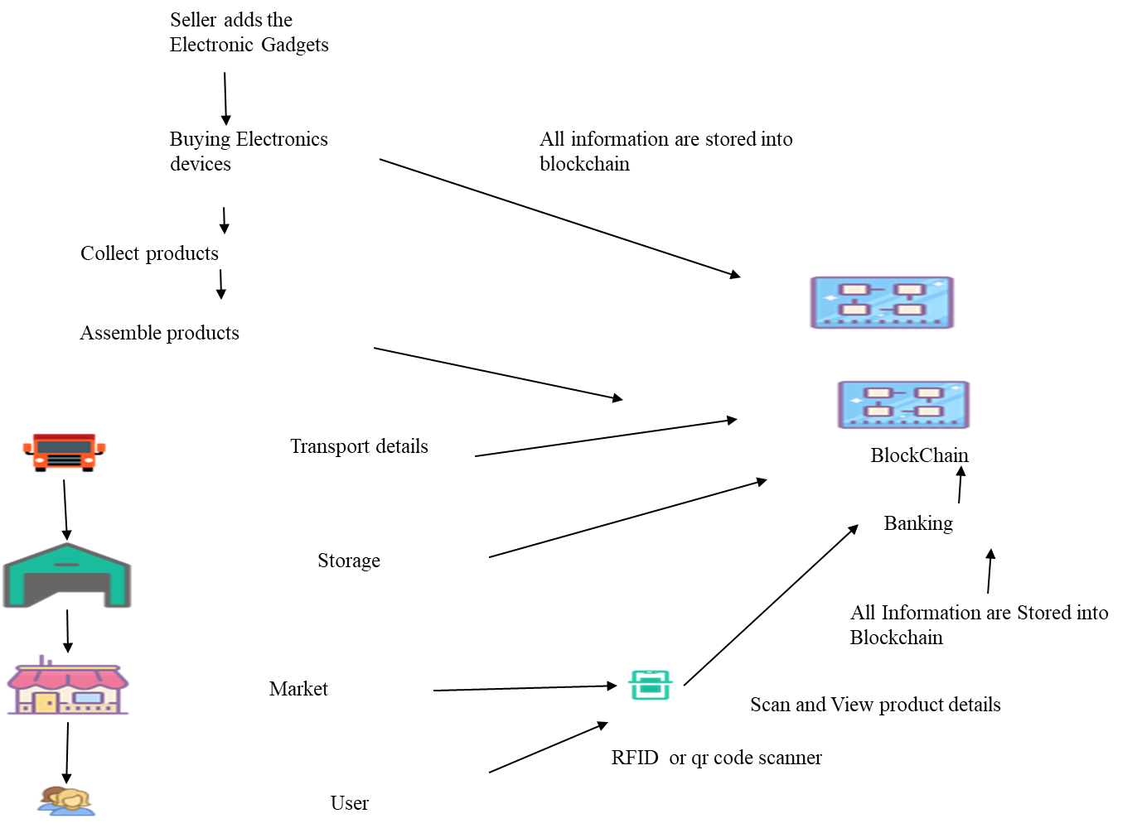
SYSTEM ARCHITECTURE

Slide 14
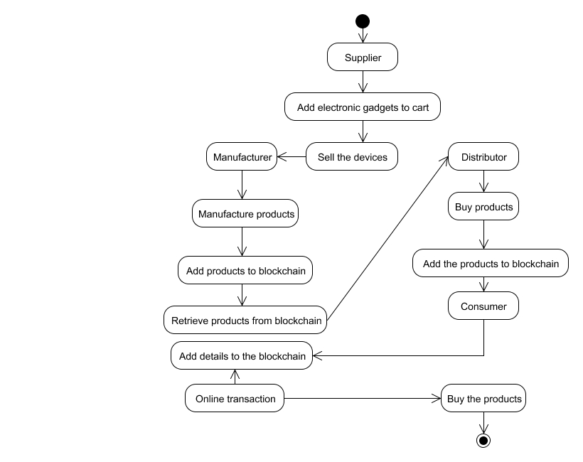
activity diagram
SYSTEM DESIGN

Slide 15
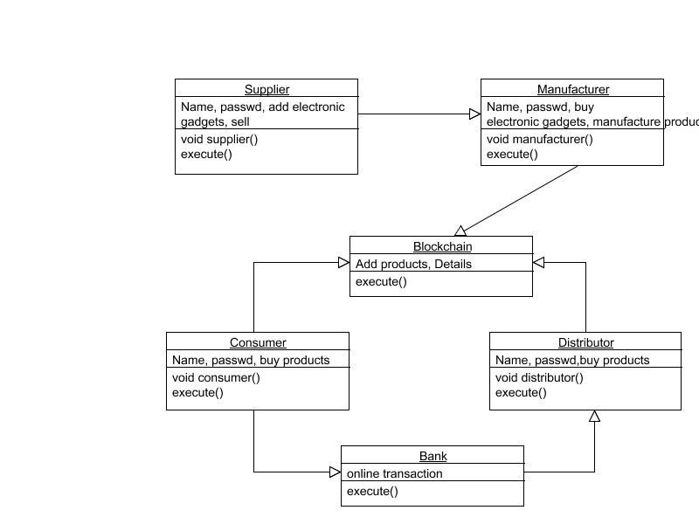
Class diagram
SYSTEM DESIGN

Slide 16
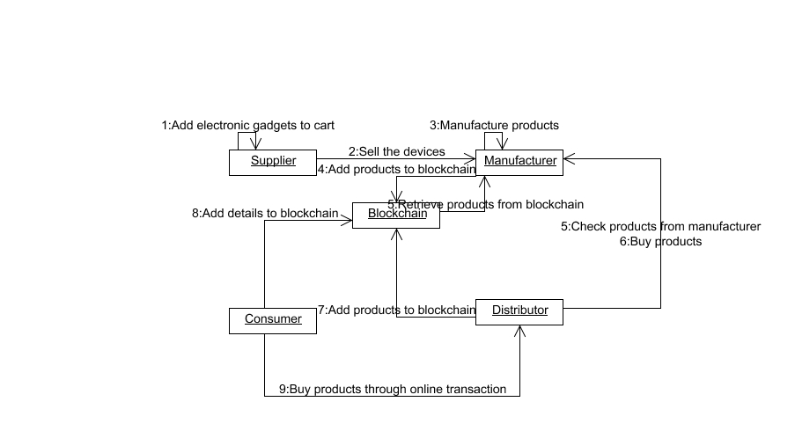
Collaboration diagram
SYSTEM DESIGN

Slide 17
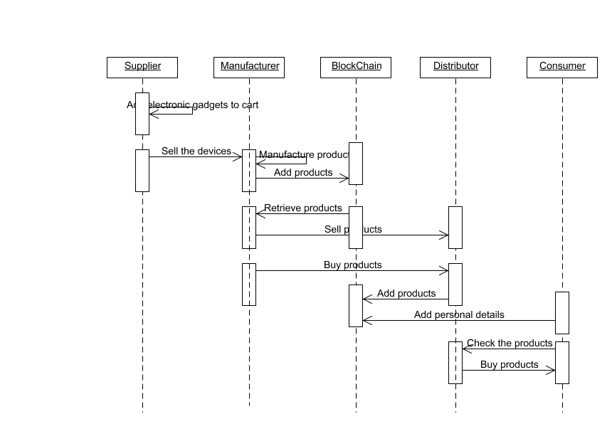
sequence diagram
SYSTEM DESIGN

Slide 18
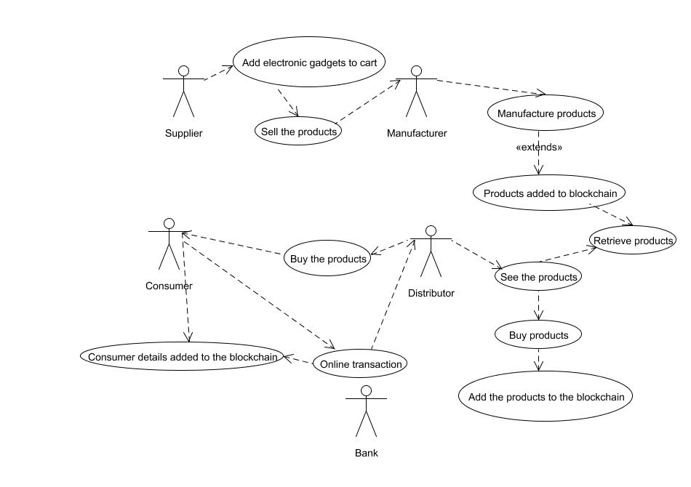
Use case diagram
SYSTEM DESIGN

Slide 19
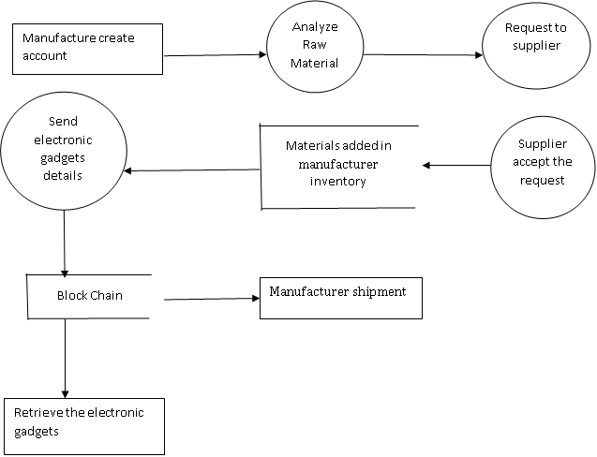
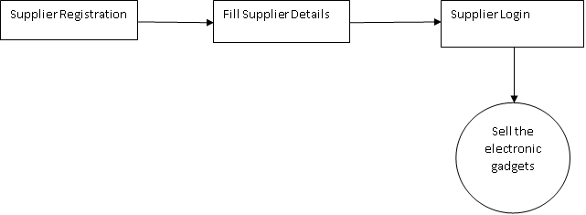
DFD Level 0
SYSTEM DESIGN
DFD Level 1

Slide 20
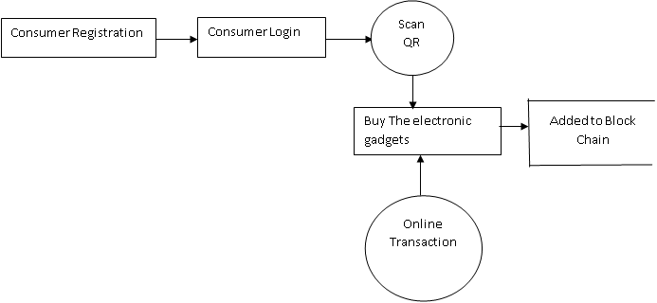
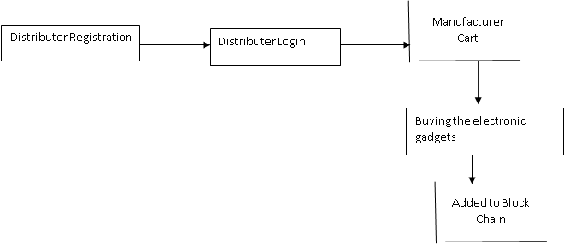
DFD Level 2
SYSTEM DESIGN
DFD Level 3

Slide 21
Modules
MODULE 1: CREATING SUPPLIERS
MODULE 2: MANUFACTURE PROCESS
MODULE 3: DISTRIBUTORS TRANSACTIONS
MODULE 4: PRODUCT VERIFICATION

Slide 22
Modules description
MODULE 1: CREATING SUPPLIERS:
First registration. The registration form contains supplier details. Then login. Supplier sells the products to all manufactures what the produce.
MODULE 2: MANUFACTURE PROCESS:
The manufacturer initially creates the account. They will analyse the raw materials and the manufacturer will request the quantity of raw materials to the supplier. Then suppliers will accept the request from manufacturer and raw material will be added to the manufacturer inventory. The manufacture will send the product ID to the block chain and then the created product will be added to manufacturer shipment. From the block chain the manufacturer will retrieve the product

Slide 23
Modules description
MODULE 3: DISTRIBUTORS TRANSACTIONS:
The registration part contains distributer details. And login. The distributer will be seeing the product in the manufacturer cart and then buying product by the distributer will be added to the block chain. The distributers maintains the KYC form for adding duplicate products, it cannot be stored in blockchain
MODULE 4: PRODUCT VERIFICATION:
There are two types of consumers. One is order the product without knowing the product details. So they cannot identify the product is duplicate or original. The second type of customer i8s view the full details of the product what they are buying so they view the blockchain content.

Slide 24
TESTING
CREATING SUPPLIERS : SUPPLIER LOGIN ANALYSIS (SCREENSHOT NO. 1)
S.NO | ACTION | INPUT | EXPECTED OUTPUT | ACTUAL OUTPUT | TEST RESULT
1. | Enter the Name, Product Type, Email, Mobile Number, Address and Password for registration of supplier | Name: XXX Product Type: RAM Email: abc@gmail.com Mobile Number: 9876543210 Address: Gandhi Nagar, Chennai Password: *** | XXX RAM abc@gmail.com 9876543210 Gandhi Nagar, Chennai *** | XXX RAM abc@gmail.com 9876543210 Gandhi Nagar, Chennai *** | Passed
2. | Compare username and password with registered field while login | Email: abc@gmail.com Password: *** | It Redirects to SupplierAddProduct web page | It Redirects to SupplierAddProduct web page | Passed

Slide 25
TESTING
MANUFACTURE PROCESS : MANUFACTURER LOGIN ANALYSIS (SCREENSHOT NO. 3)
S.NO | ACTION | INPUT | EXPECTED OUTPUT | ACTUAL OUTPUT | TEST RESULT
1 | Compare username and password with registered field while login | Email: yyy@gmail.com Password: *** | It Redirects to ManufactureLogin web page | It Redirects to ManufactureLogin web page | Passed
2 | Compare username and password with registered field while login | Email: yye@gmail.com Password: *** | Invalid Email Or Password | Invalid Email Or Password | Passed

Slide 26
TESTING
DISTRIBUTORS TRANSACTIONS : DISTRIBUTOR LOGIN ANALYSIS (SCREENSHOT 4)
S.NO | ACTION | INPUT | EXPECTED OUTPUT | ACTUAL OUTPUT | TEST RESULT
1. | Enter the Name, Email, Phone Number, and Password for registration of Distributor | Name: WWW Email: www@gmail.com Phone Number: 8888877777 Password: *** | WWW www@gmail.com 8888877777 *** | WWW www@gmail.com 8888877777 *** | Passed
2. | Compare username and password with registered field while login | Email: wew@gmail.com Password: *** | Invalid Email Or Password | Invalid Email Or Password | Passed

Slide 27
TESTING
BANK TRANSACTION ANALYSIS (SCREENSHOT 6)
S.NO | ACTION | INPUT | EXPECTED OUTPUT | ACTUAL OUTPUT | TEST RESULT
1. | Compare the amount of the product with the amount the customer have in their account in Bank Database | Account Number: 123456 PIN: ****** OTP: ****** | If amount(product) <= amount (customer have in account) Then “Amount debited from your account” | Amount debited from your account | Passed
1. | Give Account Number, PIN and OTP in the setuserpayment.jsp page to buy the particular product | Account Number: 123456 PIN: ****** OTP: ****** | Verifies whether the Account Number is present in the Bank Database and verifies the PIN and OTPIf Account Number, PIN and OTP matches with the Details in Bank Database Then Proceeds to the payment of product | Proceeds to the payment of product | Passed

Slide 28
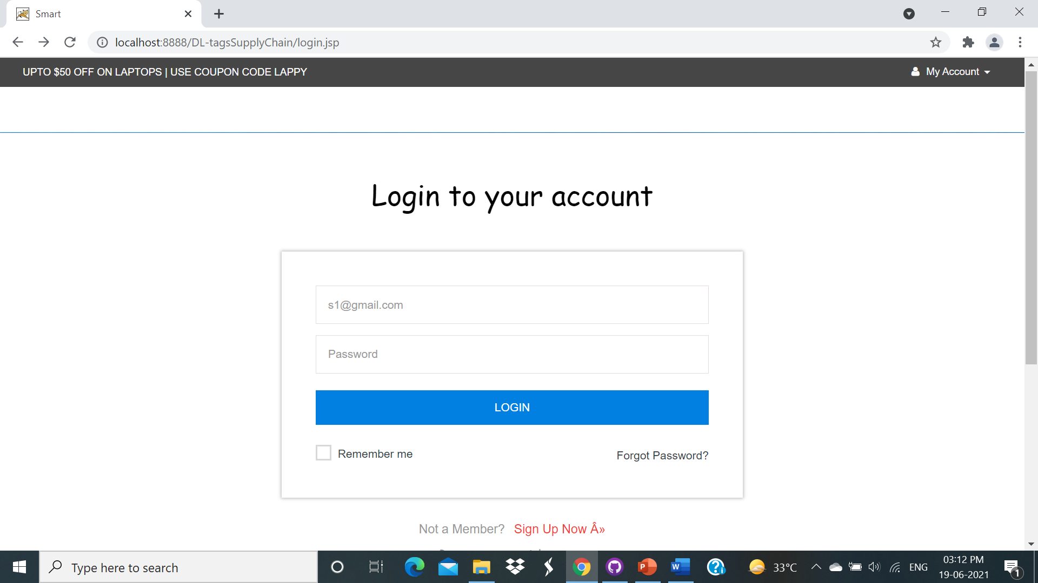
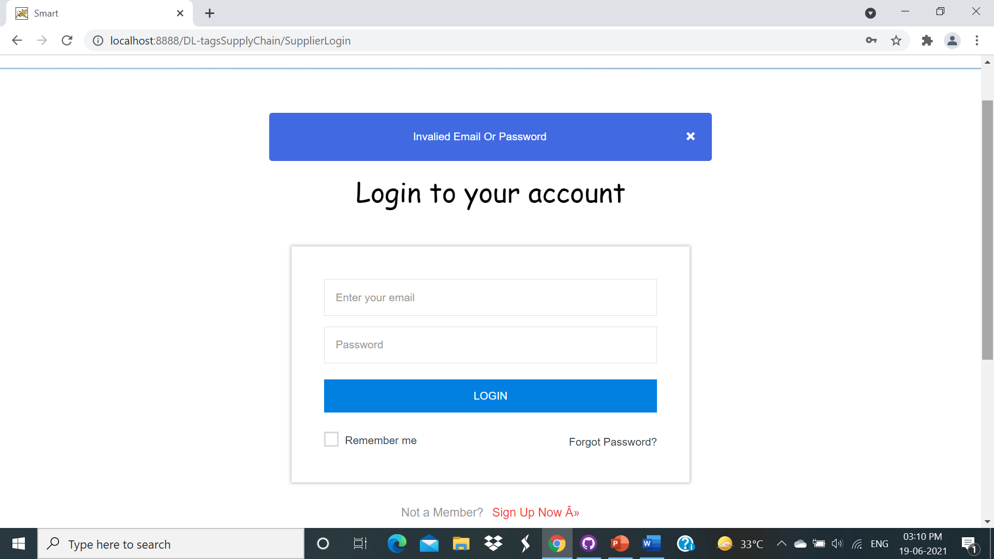
SCREENSHOT 1 - SUPPLIER LOGIN

Slide 29
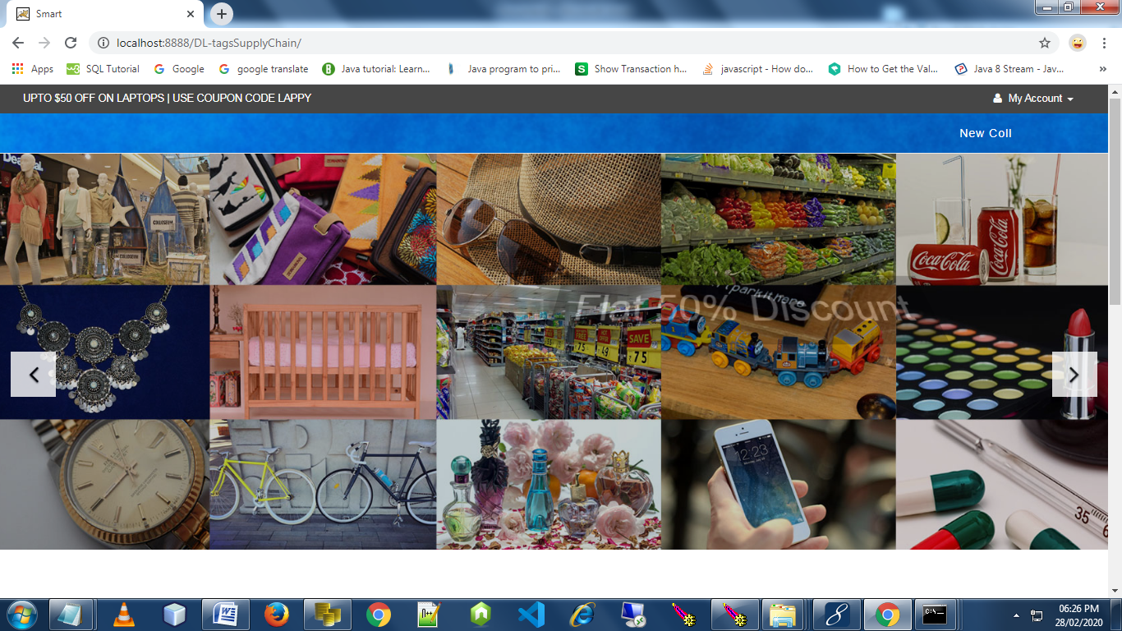
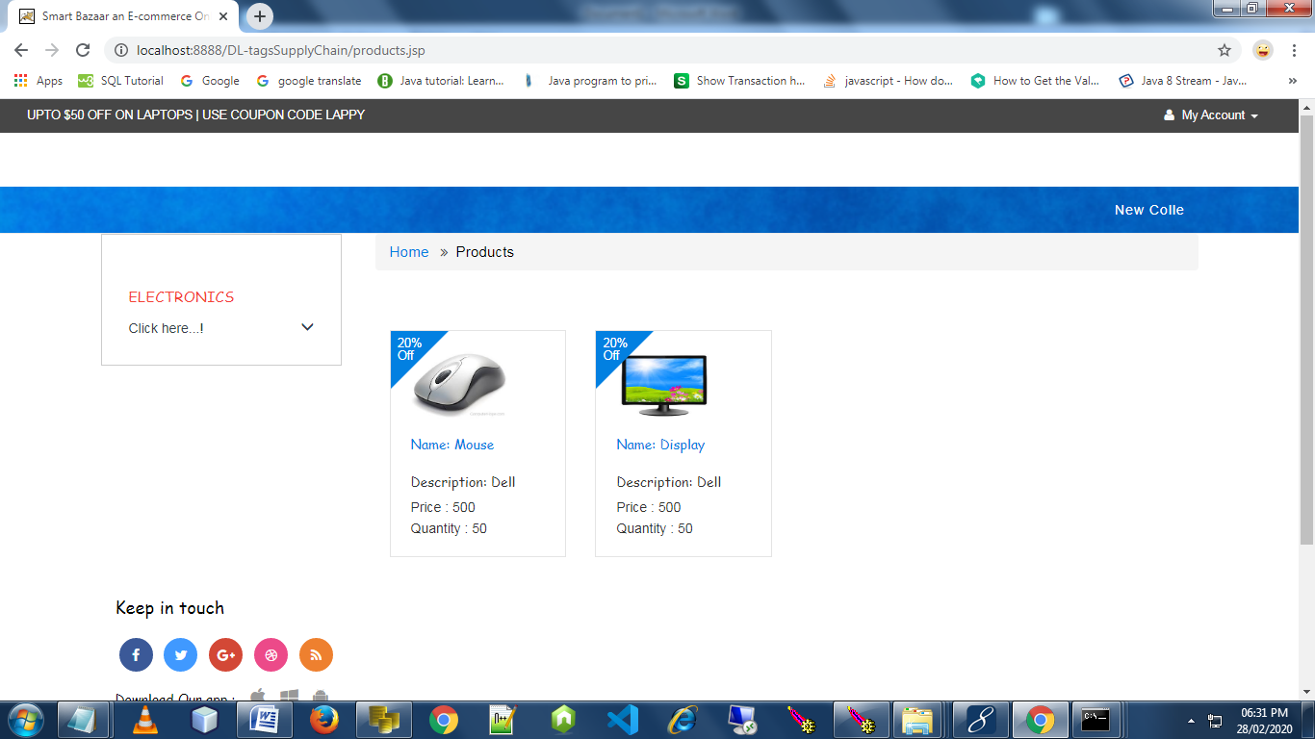
SCREENSHOT 2

Slide 30
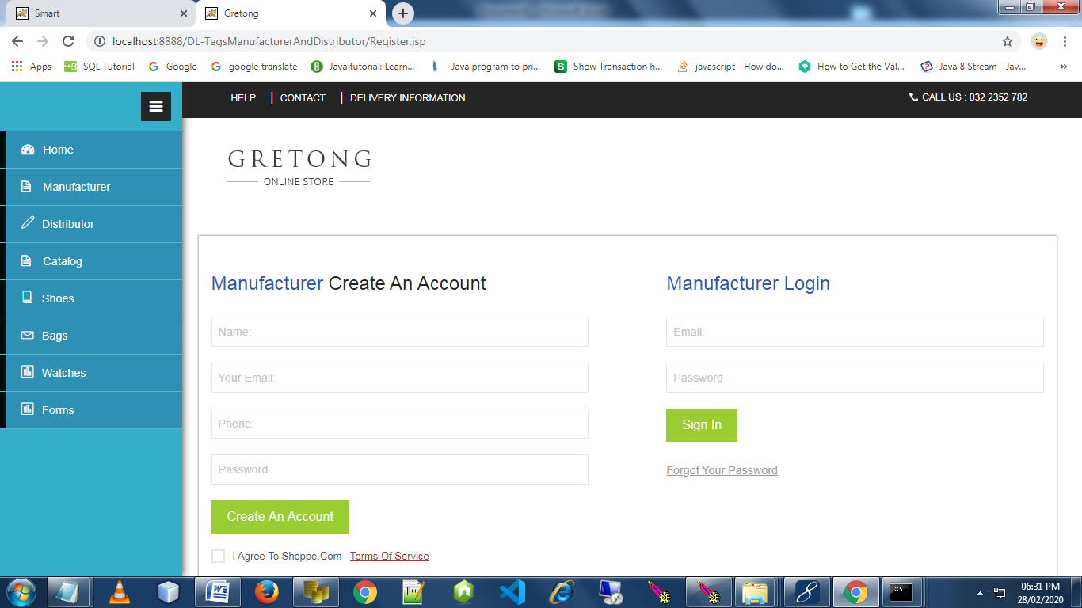
SCREENSHOT 3 - MANUFACTURE PROCESS

Slide 31
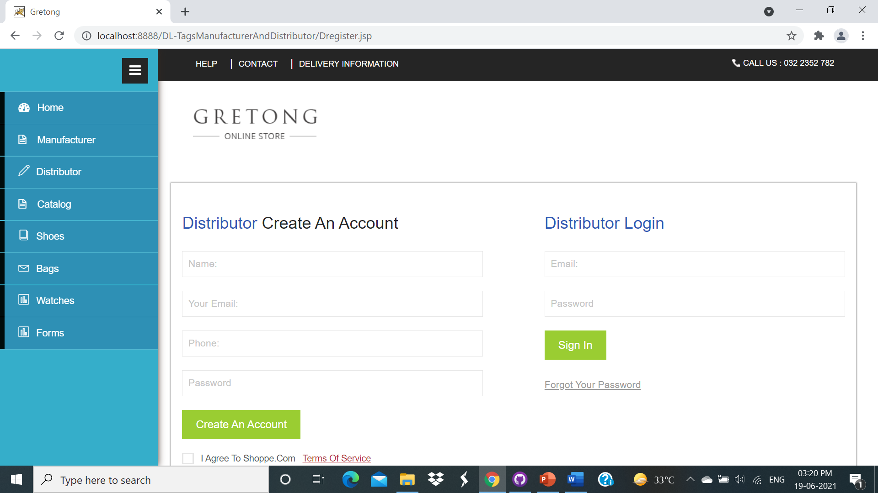
SCREENSHOT 4 - DISTRIBUTOR PROCESS

Slide 32
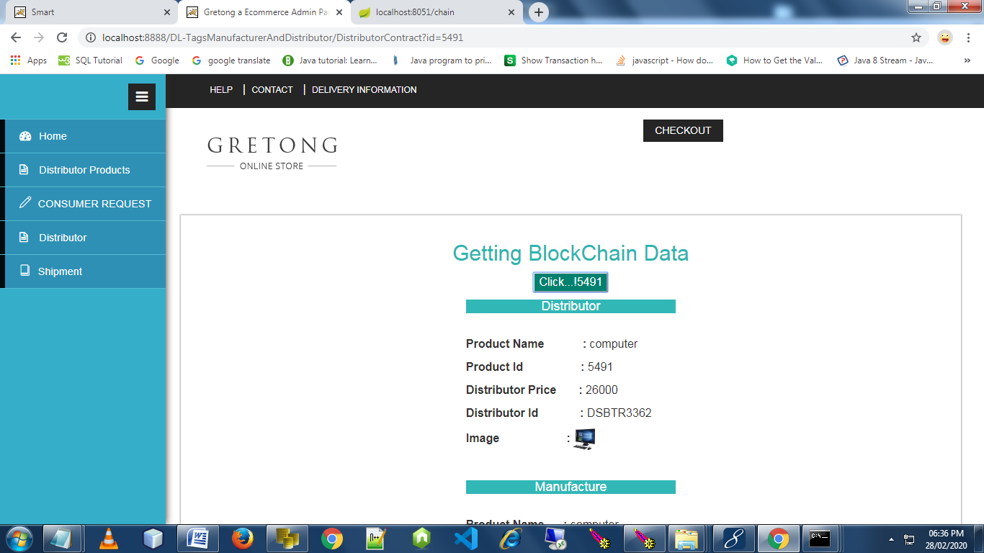
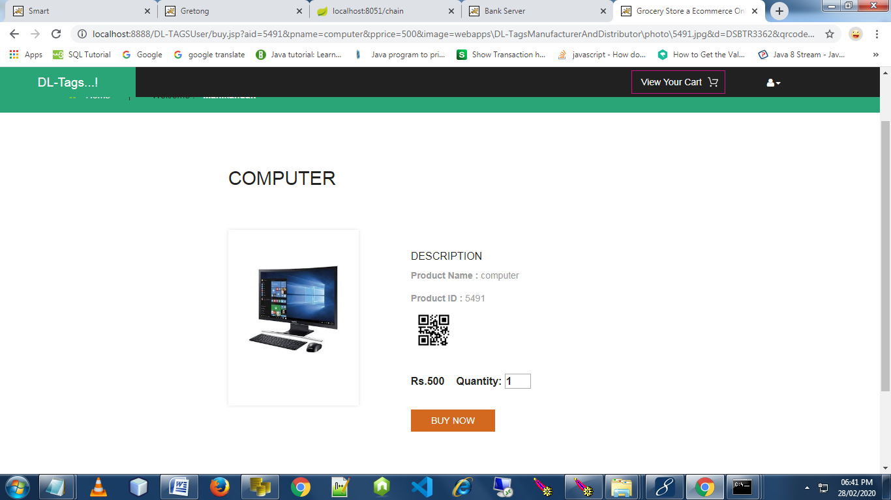
SCREENSHOT 5

Slide 33
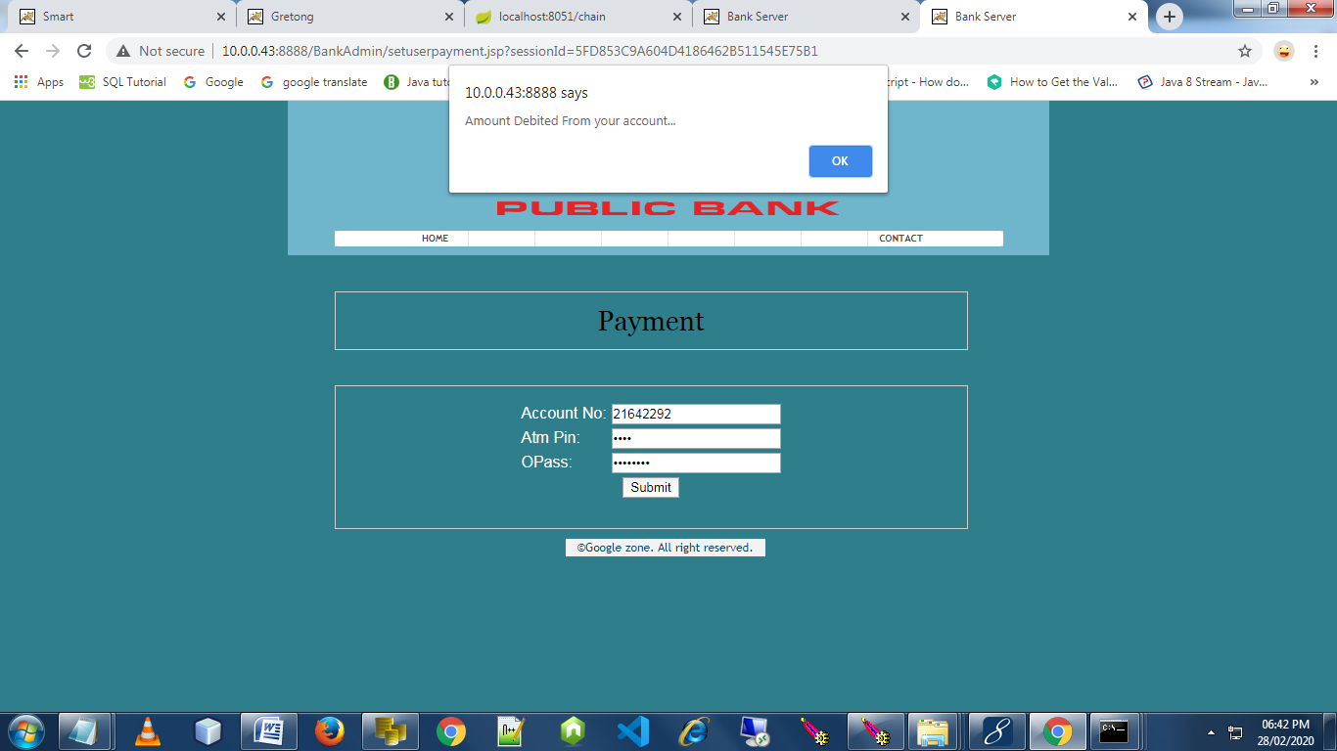
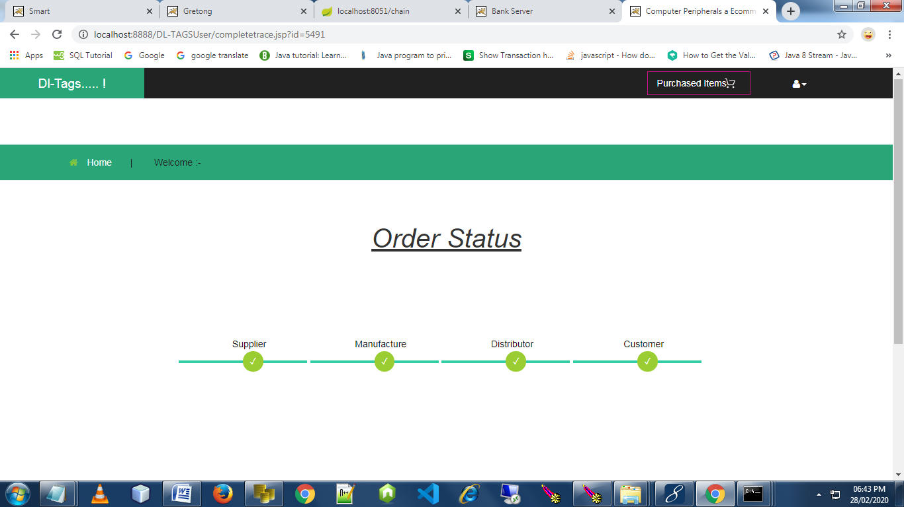
SCREENSHOT 6 BANK TRANSACTION

Slide 34
CONCLUSION
The application of blockchain in supply chain management is a boom now a days.
Blockchain has a great feature like traceability, decentralization, transparency and immutability. These features are implemented in supply chain management. With the help of this distributed ledger technology, the duplication of smart tag will be prevented.
Several interactions occur between Stakeholders during product exchange. These interactions between the participants are stored on blockchain.
Since blockchain is a decentralized network, all the transaction details are stored in blockchain.

Slide 35
REFERENCES
Blockchain and Smart Contracts for Internet of Things: A Systematic Literature Review Anup Dhakal International School of Software, Wuhan University, China, 26 April 2019 ¹.
A privacy-preserving Internet of Things device management scheme based on blockchain Qingsu He, Yu Xu, Zhoubin Liu , Jinhong He, You Sun and Rui Zhang, 2018 - 2018, Vol. 14(11) The Author(s) 2018 ²
Applications of Blockchains in the Internet of Things: A Comprehensive Survey, Ali Dorri, Salil S. Kanhere, and Raja Jurdak, 2017 ³
ETHEREUM: A SECURE DECENTRALISED GENERALISED TRANSACTION LEDGER EIP-150 REVISION (1e18248 - 2017-04-12) DR. GAVIN WOOD FOUNDER, ETHEREUM & ETHCORE GAVIN@ETHCORE.IO ⁴
First purpose built protocol for supply chains based on blockchain Authors Branimir Rakic MSc, Tomaz Levak, Ziga Drev, Sava Savic PhD(c)., Aleksandar Veljkovic PhD (c). October 5, 2017 v1.0 ⁵
Blockchains and Smart Contracts for the Internet of Things KONSTANTINOS CHRISTIDIS, (Graduate Student Member, IEEE), AND MICHAEL DEVETSIKIOTIS, (Fellow, IEEE) Department of Electrical and Computer Engineering, North Carolina State University, Raleigh, NC 27606, USA, Received April 23, 2016, accepted May 8, 2016, date of publication May 10, 2016, date of current version June 3, 2016 ⁶
BEYOND BITCOIN Public Sector Innovation Using the Bitcoin Blockchain Technology Svein Ølnes, Vestlandsforsking (Western Norway Research Institute), sol@vestforsk.no, November 2015⁷
Public versus Private Blockchains Part 2: Permissionless Blockchains White Paper BitFury Group in collaboration with Jeff Garzik (jeff@bloq.com) Oct 20, 2015 (Version 1.0) ⁸
Blockchain Technology Beyond Bitcoin: An Overview
Beyond Bitcoin Enabling Smart Government Using Blockchain Technology Svein Ølnes , Western Norway Research Institute, Sogndal, Norway , 16 Nov 2017
Privacy preserving Internet of Things: From privacy techniques to a blueprint architecture and efficient implementation Prem Prakash Jayaramana , Xuechao Yang , Ali Yavari , Dimitrios Georgakopoulos , Xun Yi, 16 March 2016

